Slide 1
MONEY MANAGEMENT
FOR STUDENT ATHLETES
Notes:
MONEY MANAGEMENT
FOR STUDENT ATHLETES

Slide 2

Hidden Slide:
Facilitator Preparation Instructions
Notes:
Facilitator Preparation Instructions
Familiarize yourself with this entire guide by reading it thoroughly and making notes for yourself in advance of presenting the seminar. Where there are [brackets] you are asked to fill in your own information so that when you are presenting you will seamlessly flow into your own specific information. Also, edit two beginning slides and each handout with your specific information in advance.
Icons used in these materials are shown on the right.
Where you see the SAY icon, feel free to read in advance and make notes so that you feel comfortable delivering the information. It is not necessary or recommended to read verbatim.
When you cannot play the videos that are part of this seminar, instead share the content information that is summarized in this guide with the group.
Suggestions for timing are provided for each element of the agenda. Keeping track of time during the presentation is a key responsibility of a facilitator. If you find that some areas take slightly longer or shorter than expected, this is typical. Just ensure you adjust for that in another section.
If questions arise that you cannot answer, acknowledge each and let the participants know you will research the answer and get back with each person individually. Ask individual(s) for their contact information, and then be sure to follow up after the seminar.
<Click to next slide to begin the seminar>
Important point for Facilitator to note
Facilitator script (Verbatim)
Restate the key points of an activity or discussion
Information for reference purposes
Ask a discussion question
Show
video clip (when possible)
Suggestions for great seminar
delivery

Slide 3
MONEY MANAGEMENT
FOR STUDENT ATHLETES
40 mins
© 2018 Regions Bank.
Notes:
Welcome!
Say: Welcome and thanks for choosing to spend your valuable time learning about financial fundamentals. My name is [your first and last name]. I am a [position with Regions] from Regions Bank.
(If you are not a banker, use the following script:
My name is [your first and last name]. I am a [position/job] from [company].
This will help to set expectations as to the depth of product knowledge you may or may not have.)
[Share a brief anecdote about yourself that indicates your excitement about the session and sets you up as a knowledgeable advisor regarding financial issues for those just starting out in life.]
<click to next slide>
TIP: Remember, get to know this material in advance so that you can seamlessly deliver it without reading verbatim!

Slide 4
Regions Next Step
This information is provided for educational and general marketing purposes only and should not be construed as a recommendation or suggestion as to the advisability of acquiring, holding or disposing of a particular investment, nor should it be construed as a suggestion or indication that the particular investment or investment course of action described herein is appropriate for any specific retirement investor. In providing this communication, Regions is not undertaking to provide impartial investment advice or to give advice in a fiduciary capacity.
This information should not be relied on or interpreted as accounting, financial planning, legal or tax advice. Regions encourages you to consult a professional concerning your specific situation and visit irs.gov for current tax rules.
Investment, Insurance and Annuity Products:
Are Not FDIC Insured | Are Not a Deposit | May Go Down in Value | Are Not Bank Guaranteed
Are Not Insured by Any Federal Government Agency |  | Are Not a Condition of Any Banking Activity
Notes:
Regions Next Step Disclaimer
Say: I hope you will contribute to our discussion during the next 40 minutes. I will be asking for your input throughout and we will have time for all of your questions before we wrap up.
This seminar is one of a series that Regions offers to the public for free. Let’s get started.
Is there anything specific you want to cover today on (insert topic) or ask another question to kill a few seconds.
<click to next slide>

Slide 5
AGENDA
Today we will address these big questions . . .
How can you manage your money?
How can you start to save money?
How can you use credit wisely?
How can you maximize your personal wealth?
Notes:
Agenda
Say: Being here today shows that you care about your financial health and you are taking an important step toward your financial future by learning about the fundamentals of money.
Today we will focus on these big questions:
How can you manage your money?
How can you start to save money?
How can you use credit wisely?
How can you maximize your personal wealth?
<click to next slide>

Slide 6
Back to basics
DEBIT
AUTOMATIC
DRAFT
INTEREST RATE
CREDIT
LEDGER BALANCE AND AVAILABLE BALANCE
OVERDRAFT
Notes:
Managing Your Money 101: Back to Basics
Say: You’re in college to gain the knowledge and skills you need for your future, but are you prepared to handle your personal finances? Before we show you how to manage your money, let’s step back and take a quick look at a few basic financial terms that everyone needs to know.
Ask: Which of these terms are familiar to you? Who can choose a term and tell us something about it?
Debrief each term fully using the following key points as mentioned:
Debit means to deduct money from an account. A check card is sometimes called a debit card because charges on the card are deducted (debited) from the checking account. When you use your check card, you may be asked to enter your PIN or sign a charge slip. In either case, the charge for that transaction will be deducted from your checking account.
The amount of money in your checking account is typically called a ledger balance. The cash available for immediate withdrawal from your checking account is typically called an available balance. Your ledger and available balance may be different depending on your pending transactions. For example, if you deposited a check to your account but your bank has not actually received funds for that check, the check may be treated as a pending transaction and your ledger balance may be higher than your available balance.
An automatic draft or debit deducts money directly from your checking account on a predetermined date. Many businesses and services encourage this method of payment. College students in particular should be aware of the advantages and disadvantages before they authorize any automatic drafts. If your account consistently has enough money to cover all of the amounts to be automatically deducted, this payment method can be a convenient way to pay bills. However, if your account may not have enough money to cover each automatic draft on the scheduled payment date, you may be charged fees by both your bank and the biller or your account may be overdrawn.
<continued on next slide>

Slide 7
Hidden Slide:
Back to Basics, continued
Notes:
Back to Basics, continued
An overdraft occurs when your bank pays a check, check debit card charge or other transaction on your account even though the transaction amount exceeds the available balance in your account. You are responsible for repaying the funds advanced by your bank to cover the overdraft – the difference between the transaction amount and your available balance at the time the transaction is paid – in addition to any overdraft fee the bank may charge for paying that transaction. To avoid an overdraft, make sure never to spend more than your available balance. Another option is to sign up for overdraft protection, a service that some banks offer that transfers funds from another account to your checking account when a transaction would overdraw your account when an overdraft occurs. You may be charged a fee for the transfer, but that fee is typically less than the fee charged if for paying an overdraft when you don't have overdraft protection.
Credit allows you to make a purchase or obtain money on the promise that you will pay the purchase price or repay the money later, usually over an extended period plus interest. Credit cards – which may be issued by banks and businesses – are one of the most common forms of credit. With a credit card, you typically have the option to pay either your full balance or a minimum payment each month. With a typical loan, you typically must pay a fixed amount each month. For any credit, late fees and other penalties may be charged if payments are not made on time. Failure to repay credit in a timely manner also will hurt your credit score and can negatively affect your ability to obtain additional credit in the future, such as financing to buy a car or house. You should not obtain credit unless you will be able to repay that credit on the lender’s required terms.
<click to next slide>

Slide 8

TRACK
YOUR SPENDING
Notes:
Track Your Spending
Say: Now that we have the basics under our belts, let’s start at the beginning. Your money – where does it go? Many people can’t answer that question easily. There is one way to be sure you can always answer that question. Track your spending beginning with your income and following through with all of your expenses.
Distribute handouts at this time. Be sure you save one for yourself to refer to.
Reference the handout: Know Where Your Money Goes: Worksheet for Spending and Saving.
Ask: Do you know where your money goes each month? Accept all answers. Encourage discussion around all aspects of the question.
Say:
It is common for people to spend the money they make and not have anything left over to save for their goals. In fact, many people say they do not have anything to show for their hard work at the end of the month.
Here’s an example that may seem familiar to you. How often have you taken $20 out of the ATM and, at the end of the day, not known where it went? Almost certainly!
To be in control of your money, you must understand your cash flow. Cash flow is about the money you earn, spend, and save. To create a snapshot of your cash flow, keep a personal spending diary over a period of time, let’s say one month. Most people uncover some surprises when they do this!
<click to next slide>

Slide 9

KNOW YOUR
INCOME
© 2018 Regions Bank.
Notes:
Income
Ask: Do you know all the ways money comes to you?
Debrief all answers. Encourage discussion around all aspects of the question.
Say: The next step in preparing a personal spending plan is to determine your monthly income and expenses. Income is money that comes to you from:
Wages
Allowance
Other sources (e.g., tips, scholarships, grants, etc.)
Ask: There are two categories of income: gross income and net income. What do you think the difference is between gross and net income?
Debrief these definitions:
Gross income is your total income without deductions.
Net income is the cash you bring home after your employer deducts taxes, social security, health insurance, 401k deductions, and so on.
<click to next slide>

Slide 10

KNOW YOUR
EXPENSES
© 2018 Regions Bank.
Notes:
Know Your Expenses
Say: Many people overestimate their purchasing power. They look at their total salary as the money available to spend; however, it is best to base your spending plan on your net income.
Now let’s talk about expenses.
Fixed expenses do not change from month to month. Typically, you do not have any control over how much you pay. Examples include rent/mortgage, insurance, car payment or other loan payments.
Variable expenses can vary based on your situation (e.g. savings, utilities, food, transportation/ gas, car maintenance, education, personal expenses and entertainment). You may have some degree of control over how much you pay.
<click to next slide>

Slide 11
PERSONAL SPENDING PLAN
MY INCOME
Take home pay | $ 1,025
Financial aid | $ 500
Other | $ 0
TOTAL INCOME | $ 1,525
MY VARIABLE EXPENSES
Savings | $ 30
Electricity | $ 50
Cell phone | $ 75
Transportation/gas | $ 150
Car maintenance | $ 25
School books/supplies | $ 75
Groceries/food | $ 200
Charity/donations | $ 20
Personal expenses/other | $ 100
TOTAL FLEXIBLE EXPENSES | $ 725
MY FIXED EXPENSES
Housing | $ 500
Car payment | $ 250
Car insurance | $ 50
Other | $ 0
TOTAL FIXED EXPENSES | $ 800
TOTAL INCOME = | $ 1,525
TOTAL EXPENSES = | $ 1,525
Notes:
Personal Spending Plan
Say: Now that we have discussed gross and net income, as well as fixed and variable expenses, let’s create a personal spending plan. You can prepare this worksheet on a monthly basis, and it will help you determine your cash flow—which includes all of the money coming in and out. The goal here should be to have more coming in than going out.
First, list monthly income sources and income amounts.
Next, list fixed monthly expenses.
The next group are your variable expenses.
Finally, sort everything in chronological order.
At this point you have created a personal spending plan. You can prepare this worksheet on a monthly basis, and it will help you determine your cash flow—which includes all of the money coming in and out.
<click to next slide>

Slide 12

WHY
SAVE?
© 2018 Regions Bank.
Notes:
Why is it important to set a goal and save?
Ask: One of the entries on your personal spending plan is Saving. Why do you think it is important to save? What kinds of things might people want to save for?
Acknowledge and debrief all answers with an encouraging smile and appreciation. After a couple of people have offered ideas and each of the points below are addressed, move on.
Emergencies such as major car repair
Goal or big purchase such as:
Spring break or summer vacation trip
New car
Education
Reference the handout: Know Where Your Money Goes: Fuel Your Savings section.
Say: Jot down some ways you can think of to increase your income and decrease your expenses at the bottom of your handout. Please be ready to share an idea with the group. <Pause to allow time for reflection.> Who will share an idea first?
<click to next slide>

Slide 13

GROW
YOUR SAVINGS
© 2018 Regions Bank.
Notes:
Grow Your Savings
Say: We can all agree that when we are saving we want to see our money grow. Making regular payments to yourself first, even in small amounts, adds up over time.
Ask: Let’s take a situation you may have been in yourself. And if you haven’t, you likely will be. Assume you have a vehicle that you use to drive to work and school. One day you unlock the door, get in, turn the key in the ignition and nothing happens. Your car needs attention and likely some sort of repair. It might be inexpensive or it might cost a significant amount. What do you do?
Debrief answers:
Get upset and panic. This is a common way to feel when you don’t know what to expect.
Call a friend or automobile club for a ride and make an appointment to get the car serviced. There is no way to know in advance what the cost of the repair might be which can be unsettling.
Say: Setting aside a little money from each paycheck to grow your emergency savings ensures that when an unexpected expense arises—like a car repair, for example– you have resources on hand to help.
<click to next slide>

Slide 14

PICKING A SAVINGS
ACCOUNT
PREVIOUSLY PAID INTEREST
MONEY IN
YOUR ACCOUNT
DAILY
MONTHLY
ANNUALLY
You earn money on
Interest is compounded
© 2018 Regions Bank.
Notes:
Picking a Savings Account
Say: You might be thinking, “Well, I better get a savings account and start saving now. I need to take advantage of free money!”
Here are a couple of things to consider when choosing an account.
Does the interest compound, and if so, when? Daily, monthly or annually? In our example we gave a simple example where the interest accrued at the end of the year. If the account you choose compounds interest more often, you earn money on the previously paid interest, in addition to the money in your account.
What is the APY? This stands for annual percentage yield. It takes into account the interest rate and compounding period to give you a single number that represents how much you will earn from that investment in one year. Using this number you can easily compare one account’s offerings to another.
Make sure you ask the bank’s customer service representative for the Truth in Savings disclosures. These disclosures list the APY and other important information that you should know about the accounts available at the bank. You can use these to comparison-shop and help you find the best deal.
Not all savings accounts are created equal.
<click to next slide>

Slide 15

Financial Growth
The Rule of 72
72
÷ 4.0%
18 years
© 2018 Regions Bank.
Notes:
The Rule of 72
Say: The Rule of 72 is a formula that lets you estimate how long it will take for your savings to double in value. This calculation assumes that the interest rate remains the same over time.
Here is how you calculate it. Divide 72 by the current interest rate to estimate the number of years that it will take to double your initial savings amount.
For example, if you invest $1000 in a savings account at a 4 percent interest rate, it will take about 18 years for your initial savings of $1000 to double.
Now that you know about the benefits of saving and how money can grow, let us look at the different types of savings and investment options available.
<click to next slide>

Slide 16


Open a savings account/product
Fund it
Notes:
Ways to Save
Reference the handout: Ways to Save: Checklist to Save Your Money section.
Say: There are two ways to save money:
Open a savings account or similar product at a financial institution
Invest
An important difference between the two is that a savings account may be federally insured while investments are usually not insured.
With a savings account or similar product:
You can make money by earning interest on the amount deposited.
The bank pays you for the opportunity to use your money.
Your money is safe, and you have easy access to it.
If your money is deposited at a federally insured financial institution, the Federal Deposit Insurance Corporation (FDIC) insures it up to the maximum allowed by law. This means that if your financial institution goes out of business and cannot pay you your money, the FDIC will make sure that you receive it up to the insurance limit.
Here are several ways to save money:
When you get paid, put a portion in savings. Direct deposit or automatic transfer make it easy.
Save at least part of any cash gift you receive.
Save your change and deposit it in your savings account monthly.
Save your income tax refund.
Let’s look at three savings options available at most banks.
<click to next slide>

Slide 17
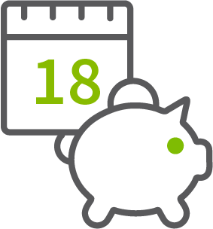


NAME THAT SAVINGS PRODUCT
CERTIFICATE OF DEPOSIT
MONEY MARKET ACCOUNT
STATEMENT SAVINGS ACCOUNT
Notes:
Name That Savings Product
Say: Now we will play a little game. I’ll call out features of these savings products and as soon as you have a guess please interrupt me with the name of the product I am describing. The three products are CD, Money Market Account, and Statement Savings Account.
A product in which you:
Leave your money for a set period of time/term like 6 months or a year
Limited deposits or withdrawal
Earn a higher interest rate with longer terms
Pay a fee if you withdraw your money before the term has ended
Answer: Certificate of Deposit (CD)
A product that:
Requires a higher minimum balance to earn interest (usually)
Pays a higher interest rate for higher balances
Does not have a fixed term
Allows you to make deposits and withdrawals
Answer: Money Market Account
<continued on next slide>

Slide 18
Hidden Slide:
Name That Savings Product, continued
Notes:
Name That Savings Product, continued
A product that:
May require you to maintain a minimum daily balance
Requires a lower minimum deposit to open
Answer: Statement Savings Account
With these savings products, you will likely receive periodic statements from your financial institution. Remember to always check your bank records and statements to be sure they are accurate.
Ask: What questions do you have about these savings products?
<click to next slide>

Slide 19

Pay yourself first.
Notes:
Wants vs. Needs
Say: Many people spend all of the money they make. But we all know that saving money is important. You may believe you do not have enough money to start saving, but today we’ll talk about some important concepts and terms related to savings, and some things you can do to start saving money now.
Ask: Call out some things that you or someone you know purchases on a regular basis and we will all determine which are wants and which are needs. Keep in mind that needs and wants are not “bad” or “good”, but it’s key to recognize which are which.
Debrief all answers. Encourage discussion around the gray areas where there is discussion as to whether things are wants or needs. For example, are new shoes a need or a want? Dinner out? A movie? And so on.
Ask: Think about a ‘want’ you could consider giving up in order to pay yourself first? How much would you save in a week? Month? Year?
Accept all answers as correct and encourage discussion.
<click to next slide>

Slide 20

Ways to Save
BUT I DON’T HAVE EXTRA MONEY TO SAVE. . .
WHAT CAN YOU DO THIS WEEK TO SAVE?
20
20
20
© 2018 Regions Bank.
Notes:
But, I Don’t Have Extra Money to Save…
Reference the handout: Ways to Save: Change Your Habits section.
Say: Creating a personal savings goal and action plan can provide a road map for successful saving.
Ask: Using your own experience and what you saw in the video, what can you do this week to begin to save? Accept all answers as correct.
Say: Even drinking less soda can add up to savings. And saving $1 a day adds up to $365 by the end of the year! What can you do next month to save? You may be able to channel money into savings by cutting costs on wants vs. needs.
What can you do by the end of the year to save? You could pay off a loan and continue making those payments into your savings account. Or if you get a raise at work, you have been living without that money… sock the extra amount away and make yourself a saver!
Ask: What can you do by the end of the year to save?
Debrief answers:
Get a part time job
Tutor
Sock the extra money away in savings
<click to next slide>

Slide 21
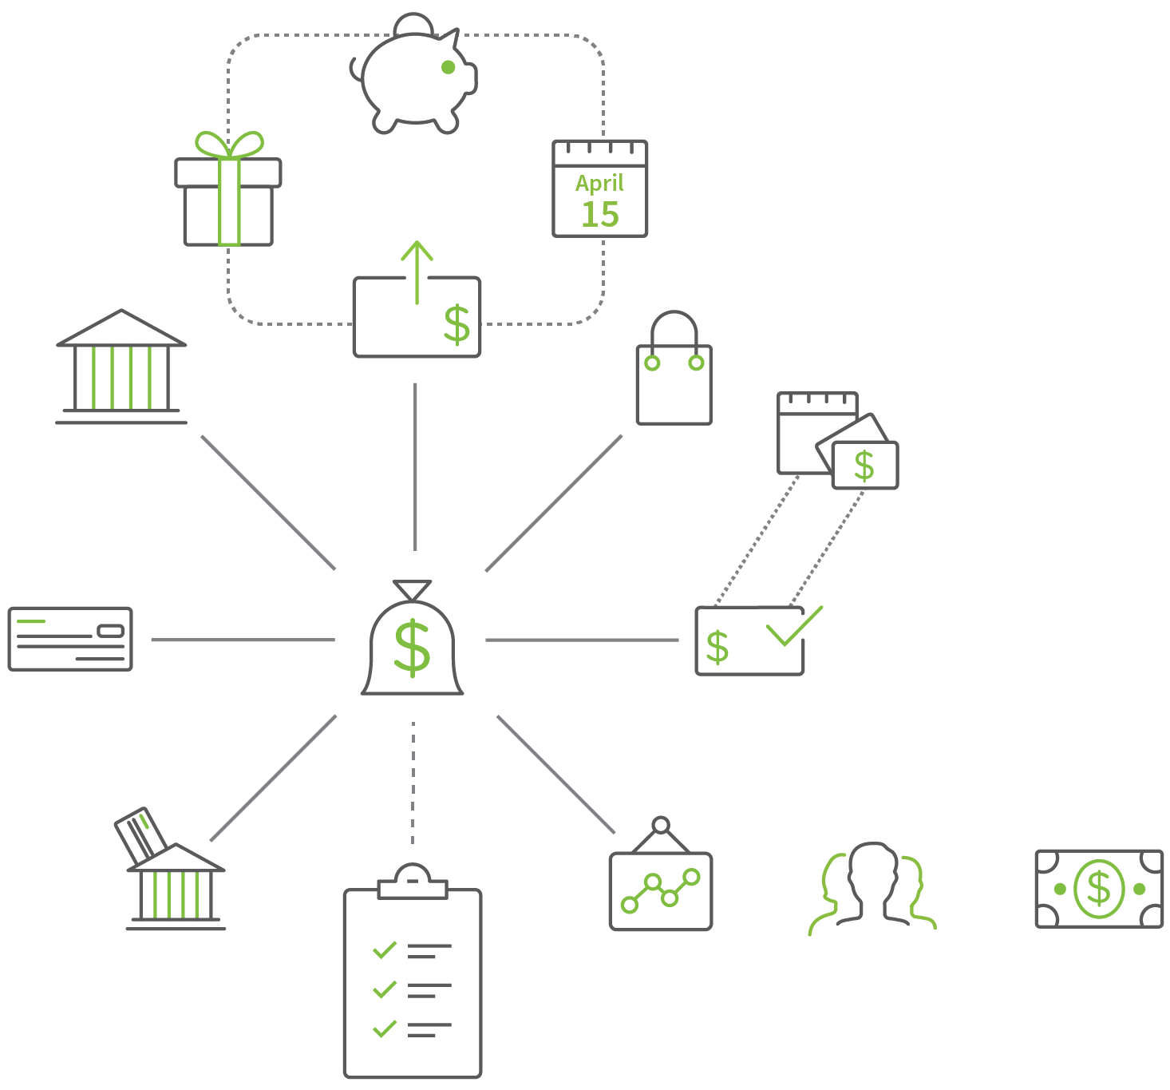

FUEL YOUR SAVINGS
SAVE CHANGE
SAVE CASH GIFTS
SAVE TAX REFUND
SAVE BONUS
USE A BANK
AVOID DEBT
3-6 MONTHS CASH SAVINGS
KEEP MAKING MONTHLY PAYMENTS
PAY BILLS ON TIME
PAY OFF CREDIT
CARDS AND LOANS
USE DIRECT DEPOSIT
REINVEST DIVIDENDS
JOIN INVESTMENT CLUB
ALWAYS TAKE FREE MONEY
Notes:
Ways to Save: Save Money & Fuel Your Savings
Reference the handout: Ways to Save: Saving to Increase Your Wealth and Financial Stability, Save Money and Invest Money sections.
Review the handout section-by-section in detail, stopping frequently to ask for questions and provide clarification. Use the slide to lead the discussion.
Reference the handout: Ways to Save: Checklist to Decrease Your Spending, Fuel Your Savings section.
Say: Try a few of these tips to save money.
Buy used textbooks and sell them back at the end of the semester.
Eat at home most nights of the week.
Combat high gas prices by carpooling on long trips, even just across town.
Consider riding your bike for fresh air and exercise. And its free!
Movie tickets can be expensive. Rent or buy a movie and host movie night at home. Or game night!
Look for BOGO (buy one, get one free) deals on items you use frequently.
Check out the thrift stores and consignment boutiques near you for cool finds at great prices.
<continued on next slide>

Slide 22
Hidden Slide:
Ways to Save: Change Your Habits, continued
Notes:
Ways to Save: Change Your Habits
Reference the handout: Ways to Save: Checklist to Decrease Your Spending, Change Your Habits section.
Say: Did you know that if you saved $125 per month, at the end of 10 years you will have $15,000? Plus any interest you may have earned! For many people cutting $125 out of the monthly budget sounds daunting. Here are some ways to change your habits while creating the habit of saving.
Comparison Shop There are the old fashioned ways like clipping coupons and visiting multiple stores to ensure you get the best deals. And new ways like like on the internet and with mobile apps that allow you to compare the price of an item through different retailers. And because many retailers now offer price match guarantees, you might not even have to drive to the store advertising the lowest price.
Use the Library for Books and Videos Checking books out of the library has always been a great way to save money over buying books at the bookstore. Now, many libraries stock electronic books and movies, so you can check those out, too, instead of buying or renting.
<continued on next slide>

Slide 23
Hidden Slide:
Ways to Save: Change Your Habits, continued
Notes:
Ways to Save: Change Your Habits, continued
Brew Your Coffee at Home That $4 cup of coffee may add up to $1000 annually. Drinking coffee at home – while not free – could make a really big difference in terms of your annual savings.
"Staycation“ The annual summer vacation may cost your family several hundred to $1000 per day. It's easy to see why the concept of a “staycation” – visiting a local hotel or destination instead of traveling is a popular way to take a break without breaking the bank.
Bring Your Own Drink Bring fresh water with you instead of buying drinks out at restaurants and convenience store—many places charge over $2 for a beverage.
<click to next slide>

Slide 24
Harnessing the power of credit
EMERGENCIES
RESPONSIBILITY
CONVENIENCE
LARGE PURCHASES
Notes:
Harnessing the Power of Credit
Say:
You have probably heard the term “good credit”.
Having good credit means that you have established a history of making your loan payments on time to repay the money you owe. If you have good credit, it will be easier to borrow money in the future.
If you have problems using credit responsibly and make your payments late or not at all, it will be harder to obtain additional credit in the future.
Ask: Using this slide for ideas, why do you think credit is important?
Debrief the following points encouraging participants to offer specific examples for each:
Credit is important because it:
Can be useful in times of emergencies
Is more convenient than carrying large amounts of cash
Allows you to make a large purchase, such as a car or house, and pay for it over time
Can affect your ability to obtain employment, housing, and insurance based on how you manage it.
<continued on next slide>

Slide 25
THE 4 Cs of credit
CAPACITY
CAPITAL
COLLATERAL
CREDIT
CHARACTER
Notes:
The 4 Cs of Credit
Say: When you apply for credit, some lenders may use the Four Cs to decide whether you are a good credit risk or in other words, whether you are likely to pay back the loan.
Capacity: Your ability to meet payments
For example:
How long have you been in your job?
How much money do you make?
Capital: Value of your assets and net worth
For example:
How much money do you have in your checking account?
Collateral: Property/assets used to secure the loan
For example:
Do you have any assets to secure the loan?
Character: How you paid your bills or debts in the past
For example:
Have you had credit in the past?
Did you pay the money back on time?
<click to next slide>

Slide 26

WHAT IS IN A
CREDIT REPORT?
© 2018 Regions Bank.
Notes:
What Is in a Credit Report?
Ask: Who can tell us things that ARE found in a credit report? It is okay to guess.
Debrief ensuring each of these are mentioned (do not get into detailed explanation and ask people with questions to hold them for a few minutes, complete definitions are coming up very shortly):
Identifying information
Credit history
Inquiries
Public record information such as collections
Ask: Who can tell us things that are NOT found in a credit report? It is okay to guess.
Debrief ensuring each of these are mentioned:
Checking and savings account balances
Income
Medical history
Purchases made with cash or check
Business account information
Race, gender, religion, or national origin
Driving record
<click to next slide>

Slide 27

Getting a Loan
Credit Report Uses
To obtain loans and other credit
To get certain kinds of jobs
For housing (rental applications and mortgages)
To obtain insurance
Notes:
Credit Report Uses
Say: This information can affect whether you get your next loan, as well as your interest rate.
Get a loan or other form of credit
Get a job
Be able to rent an apartment and/or affect the amount of your security deposit
Get insurance
Keep in mind, credit reporting agencies do not make credit decisions. Credit reporting agencies simply report the information provided by creditors. This information can affect whether you get your next loan.
<click to next slide>

Slide 28
CREDIT SCORE
How much of a credit risk are you?
300
600
850
TAKE ACTION!
VERY GOOD
EXCELLENT
BAD
POOR
GOOD
OK OR FAIR
From FDIC’s Money Smart program
Notes:
Credit Score
Say: This slide provides an example of a credit score scale established by a credit reporting agency. There are many different credit scoring models and scales out there, and what is considered a “good” credit score will vary by scale, agency, etc.
Regardless of the model used, the credit score you receive from an agency—sometimes referred to as a credit rating—is a number that can helps lenders determine how much of a credit risk you may be.
It is common for lenders, utility companies and financial institutions to use their own credit scoring model or one from another agency, and lenders often make decisions (at least in part) based on a credit score. It is sometimes the primary method they use to assess if you are credit worthy.
Knowing how these scores are calculated can help you work to improve yours, if necessary.
Credit scores may be calculated using various methods and models, including but not limited to a computer model that compares the information in your credit report to what is on the credit reports of thousands of other customers.
<click to next slide>

Slide 29
SAMPLE CREDIT SCORE
What may determine your credit score?
720
Notes:
Sample Credit Score
Most credit score models take into account several factors when assigning scores and thereby evaluating creditworthiness:
Often, the biggest factor affecting your score is your payment history. This is why it is important to pay your bills on time.
Your score may be lowered if your credit card balance is close to the limit or if you have just begun to use credit.
Sometimes having little to no credit can mean a lower credit score.
A credit score that one lender considers satisfactory may be regarded as unsatisfactory by other lenders.
One thing is certain for virtually all lenders: when it comes to obtaining a loan or a credit card, the better your credit score is the more likely you are to get a lower interest rate and pay less for borrowing money.
<continued on next slide>

Slide 30

HOW TO READ A
CREDIT REPORT
IDENTIFYING INFORMATION
CREDIT
HISTORY
PUBLIC RECORDS
INQUIRIES
© 2018 Regions Bank.
Notes:
How to Read a Credit Report
Distribute handouts at this time. Be sure you save one of each for yourself to refer to.
Reference the handout: Your Credit Report.
Ask: In the video you learned there are usually four sections of a consumer credit report. Using the handout if you need to, what are the four main sections?
Debrief each as it is named by participants.
Identifying information verifies you are who you are with information like name and birthdate and address and phone number, employer information, and so on
Credit history (sometimes the individual accounts are called trade lines) provides a “snapshot” of all the activity on your credit report
Public records include your public information related to tax liens and bankruptcies and so on
Inquiries list all the companies who have viewed your credit report in the last two years
Say: Now let’s dig deeper. Follow along on your handout.
<click to next slide>

Slide 31


Reading a Credit Report
Each Entry on Your Credit Report
Name of creditor,
account number
Type of credit
All account holders
Total amount of loan,
credit limit, highest
balance on card
Amount owed
Fixed monthly,
minimum payments
Account status
How well you
have paid
31
Notes:
Each Entry on Your Credit Report
Point out the credit history section.
Say: Each account includes the name of the creditor and the account number, which may be scrambled for security purposes. You may have more than one account from a creditor. Many creditors have more than one kind of account, or if you move, they transfer your account to a new location and assign a new number.
The entry will also include:
The kind of credit (installment, such as a mortgage or car loan, or revolving, such as a department store credit card)
Whether the account is in your name alone or with another person
Total amount of the loan, high credit limit or highest balance on the card
How much is still owed
Fixed monthly payments or minimum monthly amount
Status of the account (open, inactive, closed, paid, etc.)
How well the account has been paid
<click to next slide>

Slide 32

HOW TO GROW WEALTH
COVER
THE BASICS
INVEST WISELY
SAVE REGULARLY
Notes:
How to Grow Wealth
Say: Growing wealth often can seem complicated or even a little mysterious. After all, few people achieve wealth… so it must be very difficult to do, right? Not at all. There are three simple things that you need to do to create wealth. They are:
Make enough to cover the basics
Save regularly
Invest wisely
You may find Region’s calculator “How to Calculate Cash Flow” helpful.
People who achieve wealth do so because they practice the habits that lead to wealth. To achieve the first two things on the list—make money and save it—in other words, spend less than you make. There are two ways to spend less than you make. You can either make more money or spend less. Many people find it most comfortable to do a combination of both things.
Then, you can use the saved money as a multiplier, which we will be talking about more in this seminar.
Practicing solid financial habits (small ones), over time, creates the accumulation of wealth. Just think. The financial choices you make today might make a difference in the bottom line of your financial future!
<click to next slide>

Slide 33

CONSIDERATIONS BEFORE INVESTING
Decision Factors
How long do I have before I need the money?
How do I feel about risk?
What types of investments interest me today?
© 2018 Regions Bank.
Notes:
Considerations Before Investing
Reference the handout: Reaching Your Wealth Goals. Direct participants to the section about Considerations Before Investing.
Instruct participants to jot down notes as they come to them and to take it with them to fill out more thoroughly later.
Say: There are many considerations for building an investment strategy. An important part of investing is asset allocation. This means how much money you decide to invest in various assets in order to diversify your risk. Asset allocation is a very important decision, so here are some things you should ask yourself to help define your strategy:
How long do I have before I need the money?
With a longer time horizon, you may have a higher risk tolerance, and be more likely to find investing in high risk and return assets appealing.
How do I feel about risk? What about my spouse?
Honestly assess your tolerance for risk. The closer you get to retirement, the less risk you might want to take on. Once you determine your risk tolerance, consider assets that will align well with it.
What types of investments interest me today?
Diversify by choosing a selection of different types of investments. Many find that choosing four, five, or even ten options to be a good amount of diversification. This can protect you from the risk of ‘putting all of your eggs into one basket’.
If it seems daunting trying to go it alone you can always work with professionals in the field who can help you learn the ropes. Leverage their knowledge and expertise to make a plan to meet your financial goals.
<click to next slide>

Slide 34

Investing
INVESTMENT IS A LONG-TERM SAVINGS OPTION FOR FUTURE INCOME OR FINANCIAL BENEFITS
How do investments earn money?
Sell for more than you paid
Receive dividends and interest
earnings
© 2018 Regions Bank.
Notes:
Investing
Say: An investment is a savings option that you purchase for the future. Many banks now sell investment products (e.g., mutual funds) but they are not the same as deposit accounts because the money you invest is not federally insured.
When you invest money, there is also a greater risk of losing it than if you put your money in a savings or other deposit account. In fact, you might lose the entire amount you invest if the investment does not perform well.
On the other hand, your investment may earn and grow more than a regular savings account because of the risk you take when you invest your money.
In general, the higher the risk, the higher the expected rate of return on the investment.
You make money on investments by selling them for more than you paid for them or by earning dividends and interest. The money you earn is considered income, and you may have to pay taxes on it.
Ask: Begin to think about the level of risk you would feel comfortable with when making an investment to grow your money. It is different for everyone and it changes over time.
<click to next slide>

Slide 35
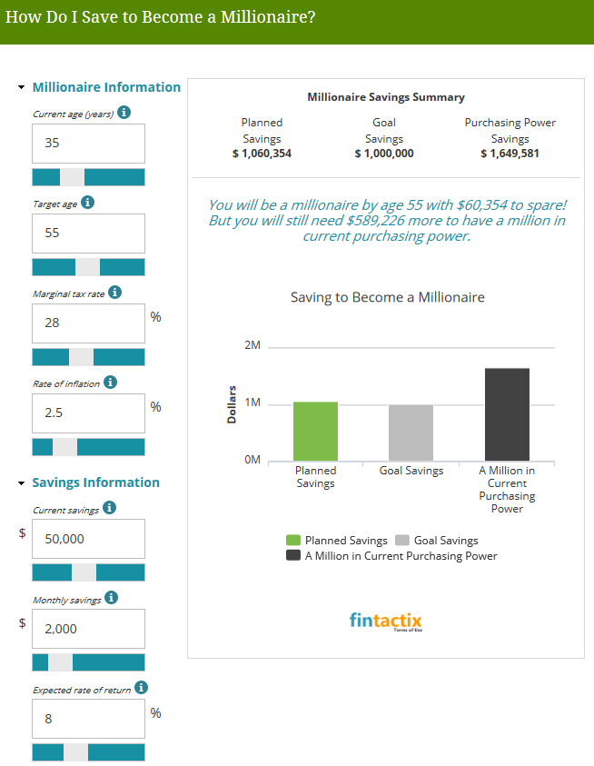
DO YOU
WANT TO BE A MILLIONAIRE?
regions.com/beamillionaire
35
Notes:
Do You Want to Be a Millionaire?
Ask: Who among us aspires to be a millionaire?
Say: No need to answer. We all want to feel financially secure and experience life with an abundance of resources. When you are successful, and you are, it is easy to treat ourselves to goodies. New cars, a boat for weekend fun, renovating the kitchen (again) or putting in a pool. And those things are fun and you should do some of them. However, I invite you to go to Regions.com/Insights when you go home today.
Reference the handout: Reaching Your Wealth Goals.
Say: At the bottom of the handout there are 2 links that we have specifically chosen for you and your financial needs. This slide shows a picture of the very second link on your handout.
Before you make your next decision to upgrade to the latest mobile device (again) or splurge on that handbag you’ve been eyeing check out our online calculators. In particular go to the one called “How Do I Save to Become a Millionaire?” This is what that calculator looks like (remember, the link is shown on your handout). Put a star or circle it so you will remember to do this later. The calculator shown here depicts what saving just two thousand dollars a month can do over the long run. Make adjustments to your situation on the left bar and see what happens to your millionaire goal. You may even be further ahead than you realized!
<click to next slide>

Slide 36

Signs of Potential Investment Fraud
Red Flags
If it sounds too good to be true, it is
“Guaranteed returns” aren’t
“But s/he seemed so trustworthy”
“Everyone is buying it”
Pressure to send money right now
Reciprocity
Unscrupulous financial advisers
Elder abuse
© 2018 Regions Bank.
Notes:
Signs of Potential Investment Fraud Red Flags
Say: Here are some red flags to look for:
If it sounds too good to be true, it is. Any investment opportunity that claims you’ll receive substantially more could be highly risky – and that means you might lose money.
“Guaranteed returns” aren’t. Every investment carries some degree of risk, which is reflected in the rate of return you can expect to receive.
“But s/he seemed so trustworthy.” You can be blinded when a con artist comes across as likeable or trustworthy. Credibility can be faked. Check out actual qualifications.
“Everyone is buying it.” Watch out for pitches that stress how “everyone is investing in this, so you should, too.”
Pressure to send money RIGHT NOW. Scam artists often tell their victims that this is a once-in-a-lifetime offer and it will be gone tomorrow. But resist the pressure to invest quickly and take the time you need to investigate before sending money.
<continued on next slide>

Slide 37
Hidden Slide:
Facilitator Preparation Instructions
Notes:
Signs of Potential Investment Fraud Red Flags, continued
Reciprocity. Fraudsters often try to lure investors through free investment seminars, figuring if they do a small favor for you, such as supplying a free lunch, you will do a big favor for them and invest in their product. There is never a reason to make a quick decision on an investment. If you attend a free lunch, take the material home and research both the investment and the individual selling it before you invest.
Unscrupulous financial advisers: Some advisers cut corners or resort to outright fraud or bilking consumers with unexplained fees, unauthorized trades or other irregularities.
Elder abuse: Many of us have aging parents and loved ones. There are an estimated 6 million victims of elder abuse annually in the U.S. It is important to make sure that we are watching out not only for ourselves but those most vulnerable in our families…because they are investment fraudsters’ number one target.
<click to next slide>

Slide 38
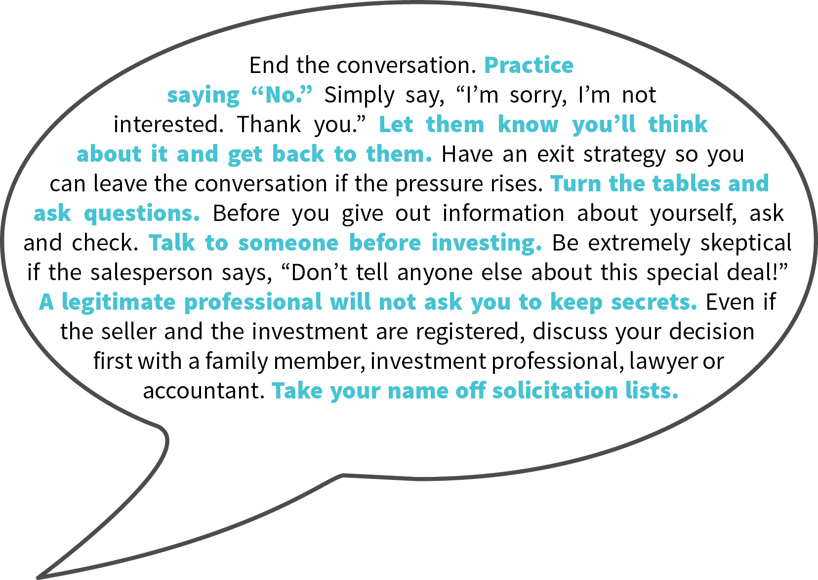
© 2018 Regions Bank.
Notes:
Preventative Measures You Should Take
Say: Refer to the Investment Fraud handout. It is the one with the graphic shown here. I won’t read everything listed, but here are a few key take-aways for avoiding investment fraud and keeping you and your money safe.
Ask questions. Fraudsters are counting on you not to investigate before you invest. Fend them off by doing your own digging.
Research before you invest. Understand a company’s business and its products or services before investing. Look for the company’s financial statements on the SEC’s EDGAR filing system.
Know the salesperson. Spend some time checking out the person touting the investment before you invest – even if you already know the person socially. Always find out whether the securities salespeople who contact you are licensed to sell securities in your state and whether they or their firms have had run-ins with regulators or other investors.
Be wary of unsolicited offers. Be especially careful if you receive an unsolicited pitch to invest in a company, or see it praised online, but can’t find current financial information about it from independent sources.
Also, on the bottom of the Investment Fraud, is a list of the contact information you need if you have questions or concerns about an investment or if you are concerned about fraud. You may want to keep this for handy reference.
<click to next slide>

Slide 39
CONGRATULATIONS
TODAY, YOU WILL LEAVE WITH:
A plan for managing your money
Tips to start saving money
Ways to use credit wisely
Ways to maximize your personal wealth
Thank you.
Investment, Insurance and Annuity Products:
Are Not FDIC Insured | Are Not a Deposit | May Go Down in Value | Are Not Bank Guaranteed
Are Not Insured by Any Federal Government Agency |  | Are Not a Condition of Any Banking Activity
Notes:
Congratulations
Say: Congratulations. You have taken the first step to ensuring you have a understanding of financial fundaments. You committed to learning more and you are leaving with next steps. You learned about:
A plan for managing your money
Tips to start saving money
Ways to begin to use credit wisely
Ideas for avoiding identity theft and fraud
Thank you for participating in this Regions Financial Fundamentals seminar about Banking Basics for Students.
[Insert information and invitation that is specific to Regions at this time. Remember that the tone and approach should be consultative and friendly. Be sure to call attention to your contact information on the handouts they are taking with them and invite them to reach out to you in the future.]
Ask: What questions do you have about financial fundamentals that we have not covered or were not clear in our discussion today?
Answer all questions as fully as possible.
Say: This concludes the formal presentation. If you have something specific or confidential then please stay after the meeting or contact me at the phone number on your handout.
<click to next slide>

Slide 40
Want to Learn More About
How Regions Can Help You
Meet Your Financial Goals?
To make an appointment with a local Regions banker:
Private Wealth Advisor: Name, phone
Financial Wellness Relationship Manager: Name, phone
Financial Advisor: Name, phone
Mortgage Loan Officer: Name, phone
Branch Manager: Name, phone
Notes:
Want to Learn More About How Regions Can Help You Meet Your Financial Goals?
Say: How can Regions help you meet your financial goals?
As I mentioned at the beginning of the presentation, I am not a banker.*
If you have questions about Regions products and services, you can make an appointment with any of our business group partners listed on the screen. Each partner manages a unique resource for you and/or your business, and would be happy to meet with you directly.
Private Wealth Advisor: [Name, phone]
Regions At Work Coordinator: [Name, phone]
Financial Consultant: [Name, phone]
Mortgage Loan Officer: [Name, phone]
Personal Lines of Insurance: [Name, phone]
Branch Manager: [Name, phone]
*(Omit this sentence if you are a banker).
[Remember that the tone and approach should be consultative and friendly. Be sure to call attention to your contact information on the handouts they are taking with them and invite them to reach out to Regions in the future.]
<click to next slide>

Slide 41
Learn more about
MEETING YOUR FINANCIAL GOALS
1
Make an appointment with a Regions banker:
Call the Regions Green Line at 1-800-REGIONS
Go to regions.com and click “Make an Appointment”
Visit any Regions branch
2
Visit the Next Step Financial Learning Center for free, online interactive videos: Regions.com/learn
3
Use our online resources including articles, videos, and calculators: Regions.com/nextstep
Notes:
More About Regions
Say: Here are three ways that many people find very helpful in extending what you’ve learned in today’s session.
As I mentioned at the beginning of the presentation, I am not a banker.* If you have questions about Regions products and services you can make an appointment with a nearby Regions banker through these convenient ways:
Call the Regions Green Line at 1-800-REGIONS
Go to regions.com and click “Make an Appointment” <If you have internet access and have allowed enough time, click on the active link and point out the Make an Appointment option.>
Visit any Regions branch
Or, access Regions.com/learn for more financial wellness topics we know our customers are interested in knowing more about. <If you have internet access and have allowed enough time, click on the active link and point out some of the topics available.>
Also, Regions.com/nextstep is a great resource for tips and calculators plus details about the products and services we offer that can help you meet your financial goals. <If you have internet access and have allowed enough time, click on the active link and point out some of the resources that are available.>
Thank you for participating in this session of Regions Next Step.
This slide should remain on the screen until the last person leaves the session.

