Slide 1
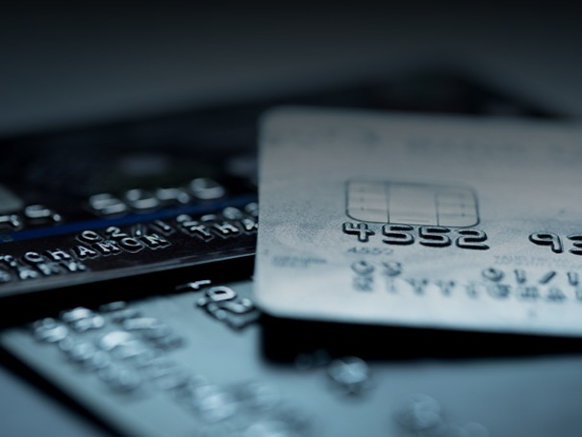

Fake Data & Statistics
New Orleans
845-945

Slide 2
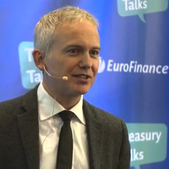
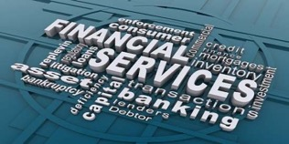


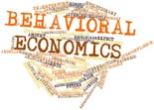
INTRO
Long time
2

Slide 3
Outline
“To teach how to live without certainty and yet without being paralysed by hesitation is perhaps the chief thing that philosophy in our age, can still do for those who study it”
Bertrand Russell
Apply learning to Commercial Payments

Slide 4











Truth ?
truth
: conformity to fact or reality
: a fact or belief that is accepted as true
Where do you get your facts from?
How differently do you feel versus 30 years ago?
Do you check if something is true? If so how…?
The Flat Earth Society
How important is the Truth?
Notes:
If you are going to look up a fact using established media then perhaps Wiki is better than Google. It’s a place where evidence is checked
Google videos search - Documentaries made with stirring music? Unilateral one sided documentary representations. Story telling – trying to provide explanations for everything…
1980’s – what would you have done? Check using Encyc? Newspapers? Friends?

Slide 5
Seeing is believing ?
..and struggling to accept the truth

Slide 6
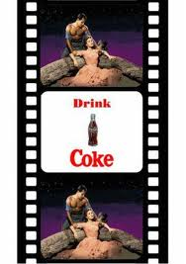

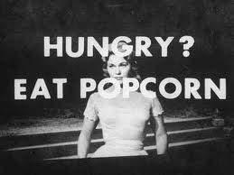


I’ve heard it before So it must be true
James Vicary
Heard of Subliminal Advertising?
1957
18%
58%

Slide 7
BUT
No evidence was ever provided about James Vicary’s experiment
The experiment was never replicated
He later retracted his claims in a TV interview

Slide 8


The truth aint what
It used to be
1789
Le grand peur
The Great Fear
2006-2017
4.5Million
126,000
Longer to get to
1,500 people
Conclusion : People prefer to share stories that generate strong negative reactions
0.1% of true stories were shared by > 1,000 people
1% of false stories managed between 1,000 – 100,000 shares
Notes:
Availability bias

Slide 9
Your experience ?
How do you establish the truth of the following statements
Product/Reporting at Bank X is better than at Bank Y?
I should focus my B2B program on low value spend
Account Manager at Bank X is better than at Bank Y?
Should I build my Business Case around a cost per PO of $90?
Will I experience less Fraud with this Provider?
Cardable B2B Spend for my program should be $Zm
More on this later

Slide 10
What can we learn from…?

Slide 11
c.570 – 475 BC

Slide 12

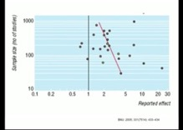
Scientific methods
Control groups
Data recording and sharing
Consideration for uncertainty
Manuscript
Publication
Peer Review
Science is an ongoing process
Study says Coffee causes
cancer
Study Says Coffee prevents
cancer
Light and Pillemer in 1984
Notes:
Problem of story telling – cohesion – Paul Slovic

Slide 13
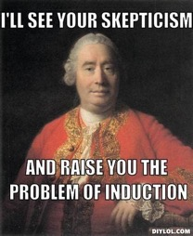
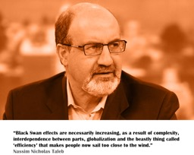
Influential contributors
David Hume
1711-1776
Scepticism
Problem of induction
Amos Tversky & Daniel Kahneman
1937-1996. 1934
Biases, Decision Making, Irrationality
Karl Popper, 1902-1994
Falsification
Nassim Taleb,
1960
Black Swans
Rare events
Anti-fragility
Notes:
skeleton in the cupboard of philosophy. (Russell?)

Slide 14

Popper : Falsification
Example : Water Boils @ 100C, right?
A Law - which no number of confirming examples will prove
100C
Falsification – find circumstances in which the law does not hold
Water does not boil at 100C in closed vessels (higher temp). So the Law is disproved
120C
The key thing is the next step in our thinking……….
>
Try to salvage our statement by narrowing the empirical content
Narrowing
knowledge
New Law - Water boils @ 100C in open vessels
Falsification – find circumstances in which the law does not hold
88C
Water does not boil at 100C at altitude
New Law - Water boils @ 100C in open vessels at sea-level atmospheric pressure
Expanding
knowledge
<
B) Ask ‘Why water boils at 100C in open vessels and not in closed ones?’
Falsify a richer hypothesis – enabling us to calculate different boiling points

Slide 15
Truth & the internet
‘Search’ data reveals interesting potential truths of what we do / say versus what we search for
We can falsify lots of theories
E.g. Are we ‘in-breeding’ / reinforcing our own opinions via the internet? Study : 2011 Study Gentskow & Shapiro
Probability someone you meet has opposing political views
Segregation
Desegregation
0%
50%
News Website
45.2%
Co Worker
41.6%
Neighbor
40.3%
Family member
37%
Friend
34.7%
Notes:
Why ? Internet news is dominated by a few sites. And strong political view people go to opposition sites … to get angry…

Slide 16
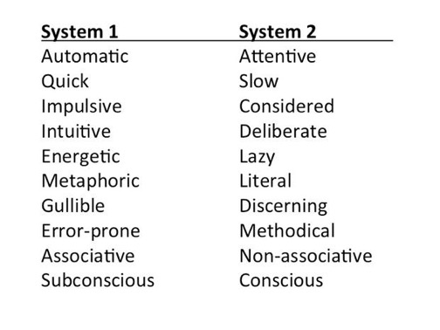
PSYCHOLOGY : System 1 and 2….
2 + 2 = 4
17 x 37 = ?
See Daniel Kahnemann, Thinking Fast and Slow

Slide 17
psychology:
Biases
Confirmation
Availability
Cognitive ease & Truth illusions (coherence)
Framing
Example of Framing
Were told
“1st month Survival rate is 90%”
Lung
Cancer
Surgery
Or
Radiation
Control Group 1
84%
Surgery
Were told
“There is a 10% mortality in 1 month”
50%
Radiation
Control Group 2
Notes:
Framing of data and evidence (Surgeons example in Kahnemann. Chances of survival vs mortality. Truth hasn’t changed but the decision did). MPG vs Gallons per mile : 12 – 10 vs 40 – 30 mpg for 10,000 miles
hysician participants were given statistics about the outcomes of two treatments for lung cancer: surgery and radiation. The five-year survival rates clearly favor surgery, but in the short term surgery is riskier than radiation. Half the participants read statistics about survival rates, the others received the same information in terms of mortality rates. The two descriptions of the short-term outcomes of surgery were:
The one-month survival rate is 90%.
There is 10% mortality in the first month.
You already know the results: surgery was much more popular in the former frame - 84% of physicians chose it, than in the latter - where 50% favored radiation. The logical equivalence of the two descriptions is transparent, and a reality-bound decision maker would make the same choice regardless of which version she saw: mortality is bad, survival is good, and 90% survival sounds encouraging whereas 10% mortality is frightening.

Slide 18
Averages
& Statistics
Averages
So many Industry reports use the Mean
The mean is a quick statistic and has its uses but it is not good at dealing with outliers and it can be easily skewed
E.g. the average human has 0.98 testicles
E.g. Average global income is $10,000
($70 Trillion / 7 billion people)
Correlation
Regression Analysis
Mean
Median
MODE
Notes:
7

Slide 19
Truth and commercial payments ?
The P2P Process is a horizontal uniform line with 6 steps
User Creates Requisition
Requisition Approved
PO Issued
Invoice Received
Invoice Approved
Manage Mis-Matches
Make Payment
Wrong
The Average cost of a PO is $90
Not a very useful statistic
BUT a very popular one
We can rule out potential suppliers for payment by card based upon average transaction size
Nope!
In fact that might rule out the largest opportunities!
Our Suppliers won’t take card due to the 2%-3% Fee
2.5%
Maybe.
But what is your evidence?
What is the cost you inflict on the supplier in the buying process?

Slide 20

Truth and commercial payments ?
Our card is accepted at X% of merchants
How is the Total population size calculated?
Data is likely to be skewed
T&E is all about Air, Hotel & Car Rental which comprises more than 65% of Spend
This may be true. But it misses the truth that they are also likely to be < 15% of transactions
> 65%
+
If we give people a card we will experience increased misuse
=
Wrong
What is the evidence? Sample size?
Card Fraud with our network is less than other networks
Like for like comparison failure
BiModal distribution ‘apples with oranges’

Slide 21
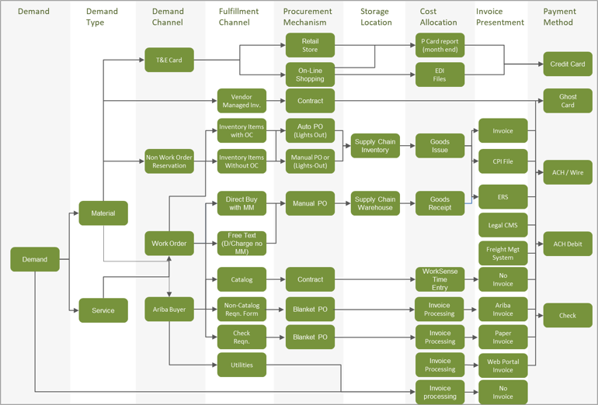
Flat uniform Horizontal P2P process ?
Demand fulfilment Channels are the “plumbing” through which an organization fulfils demand for goods and services
We have observed that in reality we can not find a single P2P process. Instead there are many… And different numbers of steps

Slide 22

$90 per PO ?
$90
Per PO
User Creates Requisition
Requisition Approved
PO Issued
Invoice Received
Invoice Approved
Manage Mis-Matches
Make Payment
* RPMG Purchasing Card Benchmark Report 2014
$x/PO
$y/PO
$z/PO
$ /PO
$ /PO
$ /PO
$x/PO
$y/PO
$z/PO
$ /PO
$ /PO
$ /PO
Multiple fulfilment channels mean cost per PO must vary by channel
And as such the $90 cost per PO is not meaningful.
Instead there should be a cost per channel
Our data tells us suppliers are paid 2.7 different ways… on average ☺

Slide 23
$90 per PO ?
Example of data for a client
In this real world example, the range is $35 to $5,333 per PO

Slide 24
2.5% Fee objection from supplier?
What about the 2.5% Fee if you moved transactions for these suppliers and moved transactions to low cost channels e.g. Catalogues already in place

Slide 25
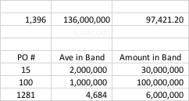
Rule out suppliers based upon ave po?
Mean
$97,758
Median
$4,980
Mode
$5,800 & $3,200
The supplier was skewed by a low number of high value blanket PO orders
> 1,200 x p.a. transactions were around $3,000 - $5,000

Slide 26
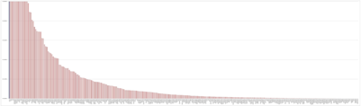
T&E is all about Air,
hotel & Car hire ?
% T&E Spend | % T&E Transactions
43% | 7%
22% | 8%
3% | 3%
32% | 82%
Total Population of Merchants globally | Your target number of those merchants
5,000 | 50-150
500,000 | 2,000 - 15,000
3,000 | 20 - 150
10,000,000 | 50,000
? | Xx – 300,000
? | 365,000
Air
Hotel
Car
Food & Bev
Transactional analysis provides a different truth
Other
Total
68%
% of T&E Transactions
Less than $75
And forces us to think about the problems we are trying to solve
30%
% of T&E Transactions
Less than $20

Slide 27
Card misuse……. A rare event
 | Employee Misrep (Misuse) | Internal Fraud | External Fraud | Total Fraud
Median $ Per Incident | $200 | $350 | $100 | $133
Loss to Organization as % of Card Spending |  |  |  | 0.0072% (i.e. 0.000072)
$500million Sales Revenue Company
$10million Card Opportunity
Approx. 40,000 Transactions
Total Benefit = $1,166,500 Process Savings $1,068,000 + Rebate $80,000 + Working Capital $18,500
Expected Fraud = 0.000072 x $10,000,000 = $720
Losses due to Fraud = Zero (covered by CLW insurance)
Example
For Every $1,000,000 spend there is no more than $72 of Fraud and Misuse in Total
Versus a Value in return for the Company in Process Savings for every positive Transaction any where from $70-300
Cards are generally safe payment instruments – they potentially make misuse / fraud more visible than other payment methods

Slide 28
Lower Card Fraud in a network
This was used by a Network in the context of a Commercial Card RFP for a $1billion T&E program to demonstrate lower Fraud experience vs others
There are several reasons why this an irrelevant truth
These data refer to general purchase volume i.e. Consumer Cards
Commercial Card instruments have much lower fraud
Clients are for the most part indemnified from fraud

Slide 29
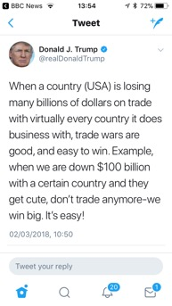
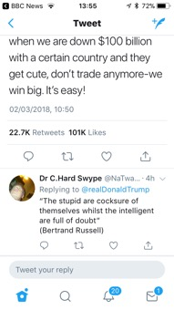
In summary
Be sceptical but not cynical
Check for plausibility
Try to establish and level your biases (System 1 & 2)
Think about ‘averages’ and whether they are appropriate
Press for evidence
Try to falsify a theory (especially where someone is more certain!)
Evaluate what you learn from your approach in trying to disprove
Look for sources of data and the scientific method
Beware of anyone predicting the future – ask for their credentials in having predicted the present
Seek out alternative opinions to those of your own and value the dialogue
Realise and acknowledge that for somethings you have to go with the ‘feel’ – which account manager is better than another?
Notes:
Beware of anyone or any article which is CERTAIN…

Slide 30

QUESTIONS
MD & Partner
PayTech Commercial
www.paytech.no

Slide 31
Primary Sources
Daniel Levitin a Field Guide to Lies and Statistics
Charles Whelan naked statistics
Bryan Macgee Karl Popper
Daniel Kahnemann Thinking fast and slow
C.S. Pierce The Fixation of Belief
The Economist Truth and Lies online MIT Study 2016 - 2017
Seth Stephens Davidowitz Everybody Lies
Ben Goldacre I think you will find it’s a bit more complicated than that

