Slide 1
Integrated Payables Powered by Regions Intersect

Slide 2
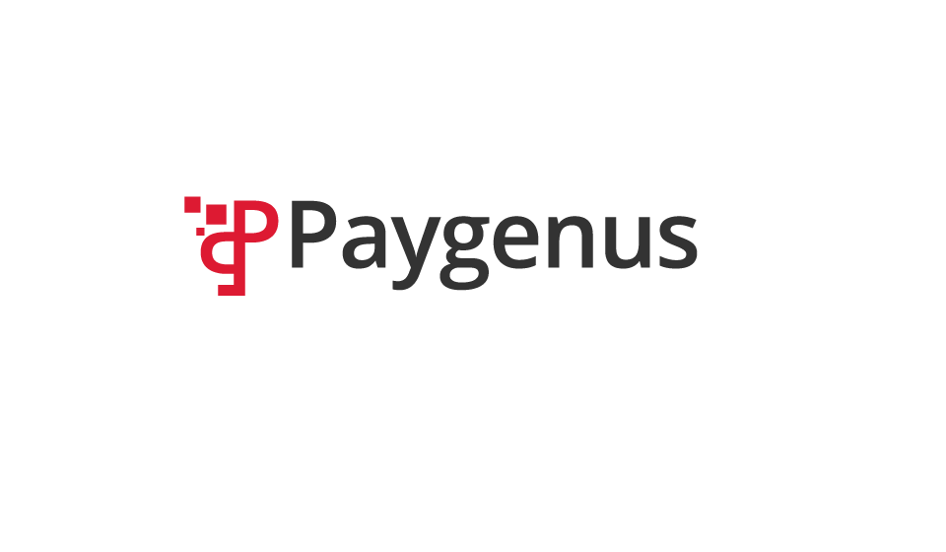
Intersect & Paygenus
Intersect - One File with Dynamic Payments
Payables
Optimization
INTERSECT

Slide 3
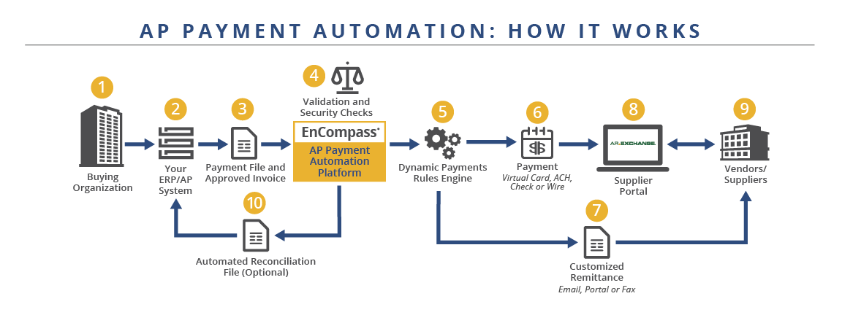

Intersect - One File with Dynamic Payments

Slide 4
Intersect - One File with Dynamic Payments

Slide 5
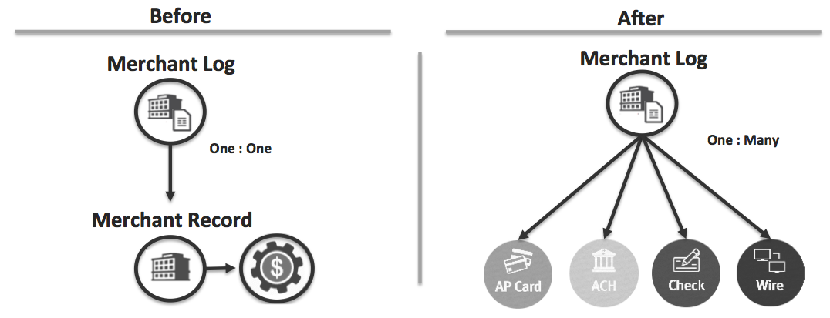
Intersect - One File with Dynamic Payments
  Dynamic Payments allow Buyers to pay their Suppliers using different methods based on payment attributes.
Buyers can choose to manually assign the payment method at the time of payment or define business rules to assign different payments methods based on payment attributes like amount or date.
Buyers can implement Organization-wide payment policies, i.e. “All payments over a certain amount must be paid by ACH.”
Buyers can create dynamic payment rules at the Supplier level.
Available for defined merchants and one-off payments.
Payment rules can be overridden if permissioned and using specific AP parser

Slide 6
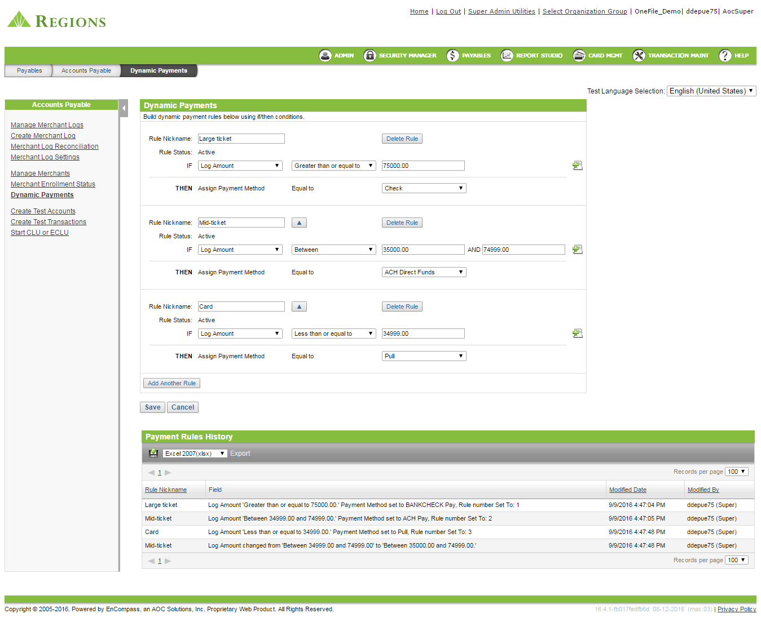
Intersect - One File with Dynamic Payments
Business Rules Engine
A – Rule Nickname: Large Ticket
  Amount Greater than or equal to $75K
  Payment Type = Check
B – Rule Nickname: Mid Ticket
  Amount Between $35k - $74.9k
  Payment Type = ACH Direct Funds
C – Rule Nickname: Card
  Amount Between $0 – $34.9k
  Payment Type = Card
A
B
C

Slide 7
Intersect - One File with Dynamic Payments
Other frequent use cases we’ve seen:
Switch payment types on a specific date
Different currency types can require different payment methods (e.g., CAD requires Wire)
Requests for payment types based on supplier type (MCC or MCCG)
Manual Payment Overrides:
  Wire transfer for taxes and late supplier payments
  Check payment for refunds, personal payments, refunds/error reversals
  Card for one-time purchases on supplier-hosted websites

Slide 8
Intersect - One File with Dynamic Payments

Slide 9
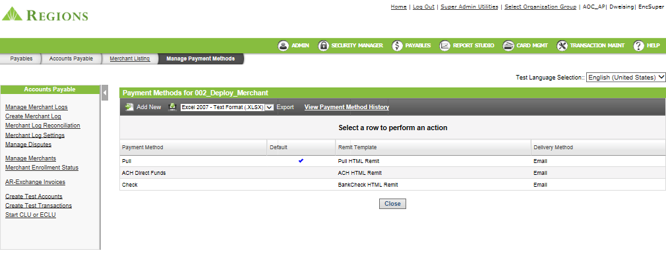
Intersect - One File with Dynamic Payments

Slide 10
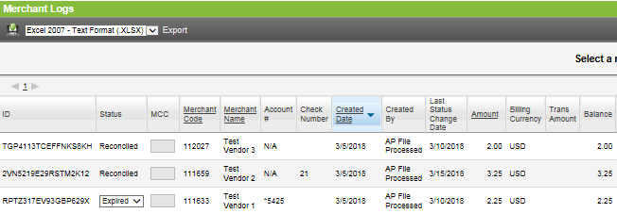
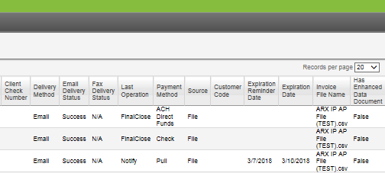
Intersect - One File with Dynamic Payments

Slide 11
Intersect - One File with Dynamic Payments

Slide 12
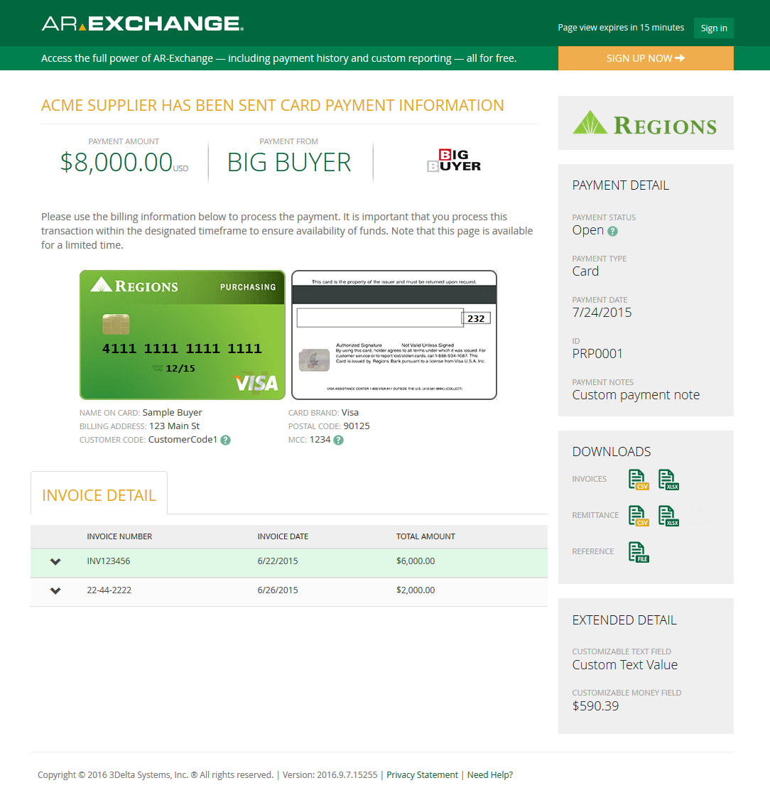
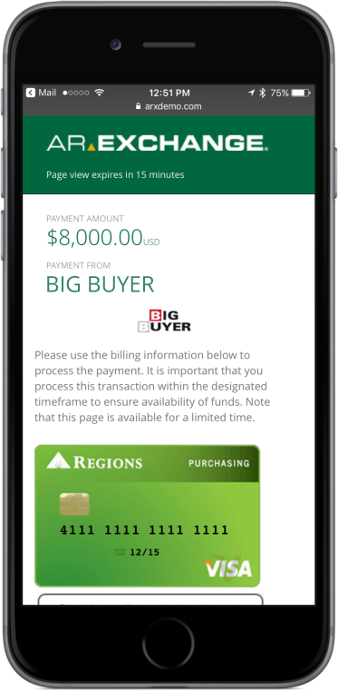
AR-Exchange Quick View

Slide 13
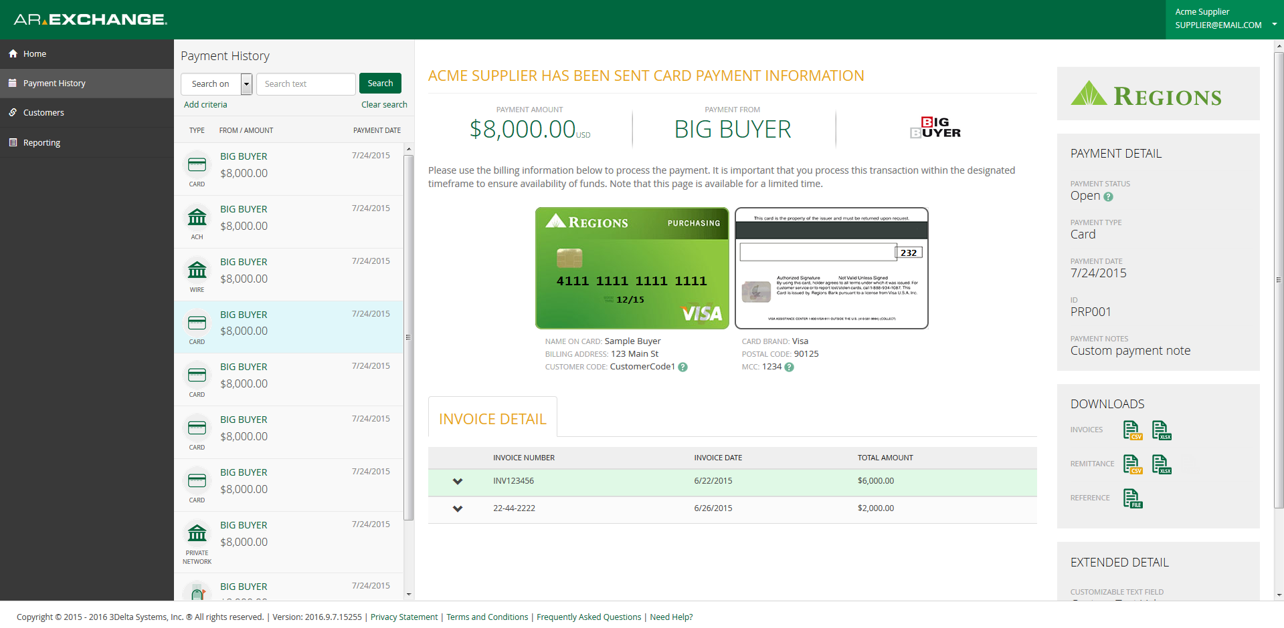
AR-Exchange Portal

Slide 14
Vendor Engagement Strategy
1. Scrub and segment Target Suppliers (volume, spend, type, Top 25, industry, cash forward, etc.) | 2. Internal Communications (AP, Treasury, Procurement, Operations, etc.)
3. Waterfall Approach - payment types, ACH, check run strategy, etc. | 4. Obtain Cash Forward Reports
5. Set goals, timelines, and milestones | 6. External Communications (Letters, emails, scripts, microsite)
Plan
1. Executive Letters (CFO) | 2. Phone Campaign
3. Check Stuffers | 4. Emails
5. Joint Strategic Calls | 6. Microsite
Do
1. Weekly Progress Reports (Goals, Enrolled, volume, type, etc.) | 2. Monitor Payments – Follow-up Calls
3. Supplier feedback | 4. Campaign Adjustments
5. Best Practices | 6. Market trends
Review
14
14

Slide 15
What is Paygenus?
Delivering Value Across the Supply Chain
15
15

Slide 16

A powerful B2B payment network that connects buyers and suppliers delivering simplified payment execution.
MEMBERS EXPERIENCE
A standardized approach to payment processing
Cost savings and improved cash flow
A balanced approach across the financial supply chain

Slide 17
Why Paygenus?
For Buyers
Powers our Integrated Payables which accelerates the move to electronic payments and comes closer to achieving the perfect payment
Flexible framework
multiple payment types
migrate to electronic payments Day One
reduce costs
optimize discount opportunities
simplify integration / remittance / reconciliation
PAYGENUS VALUE
Hundreds of thousands of network participants

Slide 18

Why Paygenus?
For Suppliers
Streamlines receivables by becoming a member of the Paygenus Payment Network
faster electronic payment delivery
full remittance data
reduce DSO
reliable, secure settlement
better visibility over payment timing / details
accelerate the sales cycle / lower cost
PAYGENUS VALUE
Hundreds of thousands of network participants
18
18

Slide 19
Leaving the Check Behind
Overcoming barriers is critical to success
Resistence to change from suppliers
38%
Difficulty of integrating with financial system
36%
No compelling reason to change
28%
Risk management issues
25%
Cost of new technology required
25%
Difficulty changing payments processes
21%
Risk of damaging supplier relationships
19%
Lack of support from the top
13%
Difficulty coordinating with multiple banks
8%
Other
6%
“Regions is well positioned to
remove each of the
barriers associated with
making the conversion to
electronic payments.”
- CFO of Fortune 1000
19
19

Slide 20
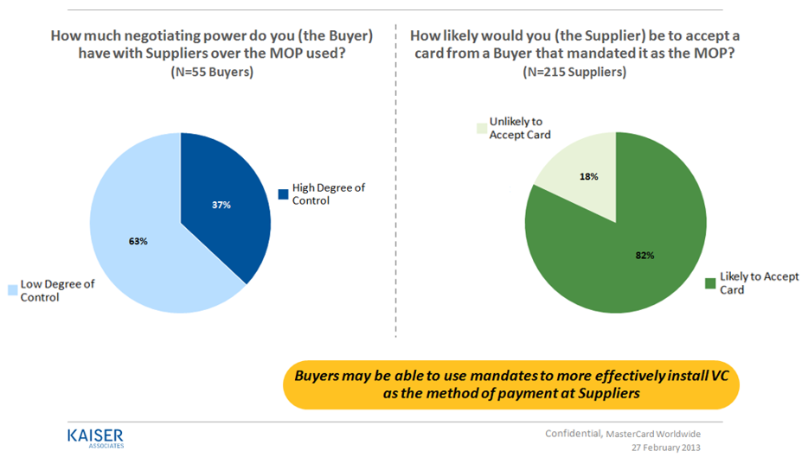
A Supplier’s Perspective of Virtual Accounts

Slide 21
Optimize your Accounts Payables Integrated Payables Powered by Regions Intersect

